Slide 1
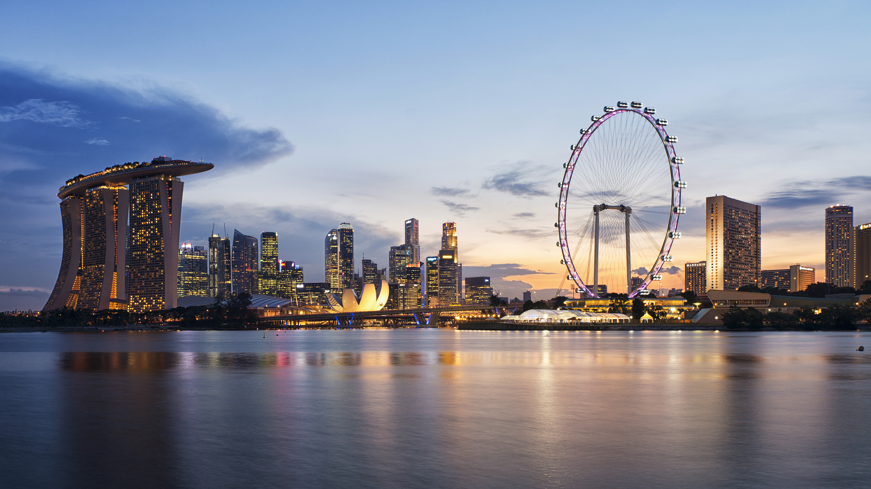
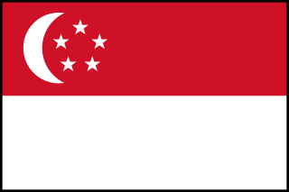
Singapore
My Dream Country

Slide 2
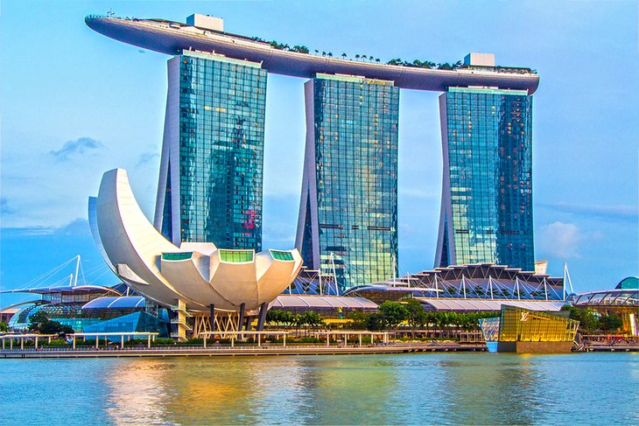
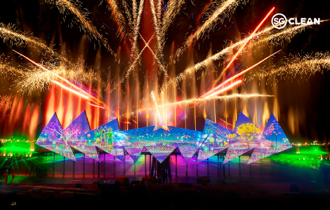
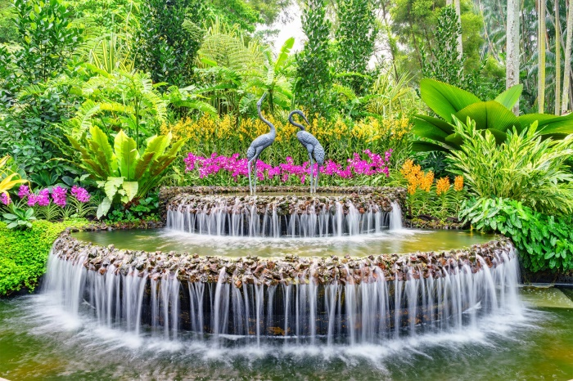

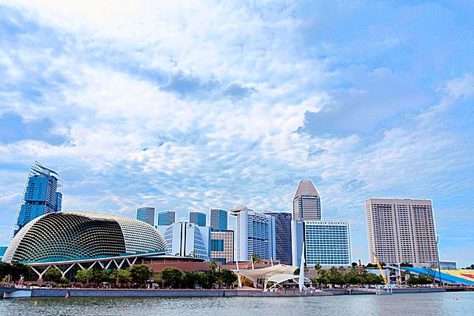
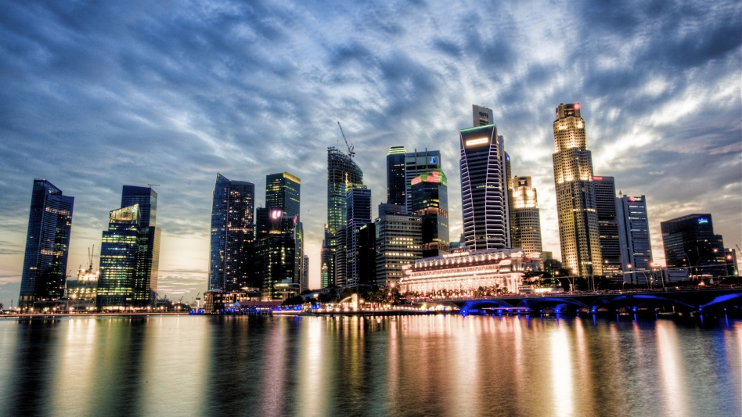
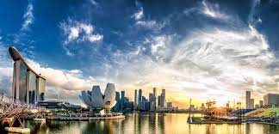
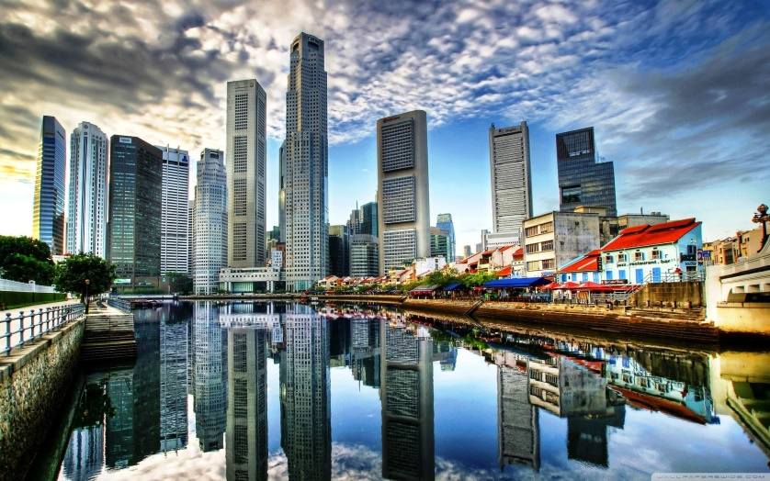
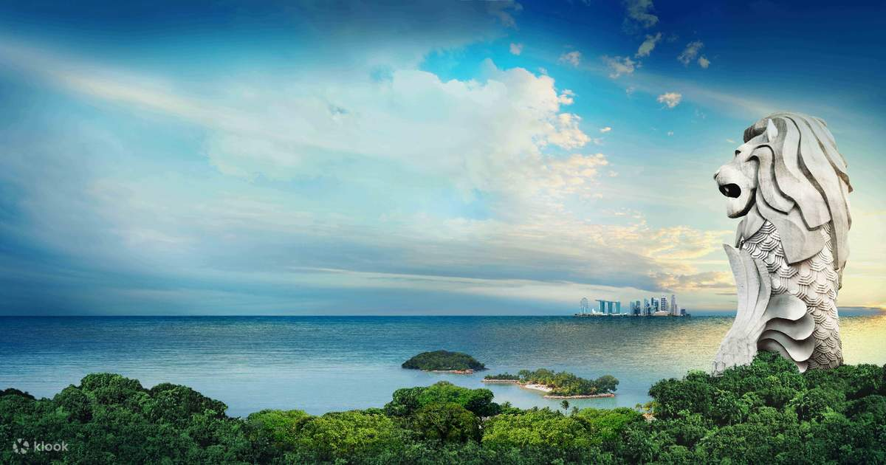
Singapore
Singapore is a sovereign Island country and city-state in maritime Southeast Asia.

Slide 3

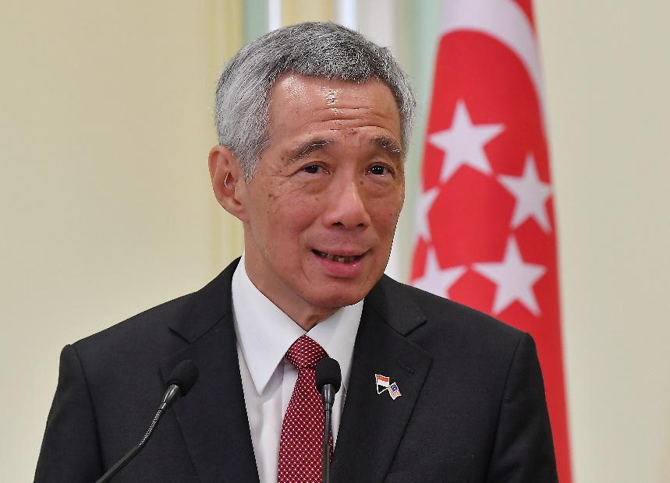
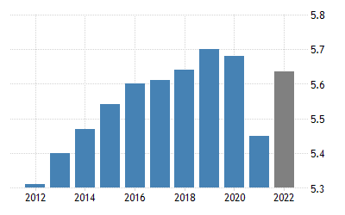
Primary Minister – Lee Hsien Loong
Currency – Singapore Dollar
Population – 5.68 Million (2022)

Slide 4
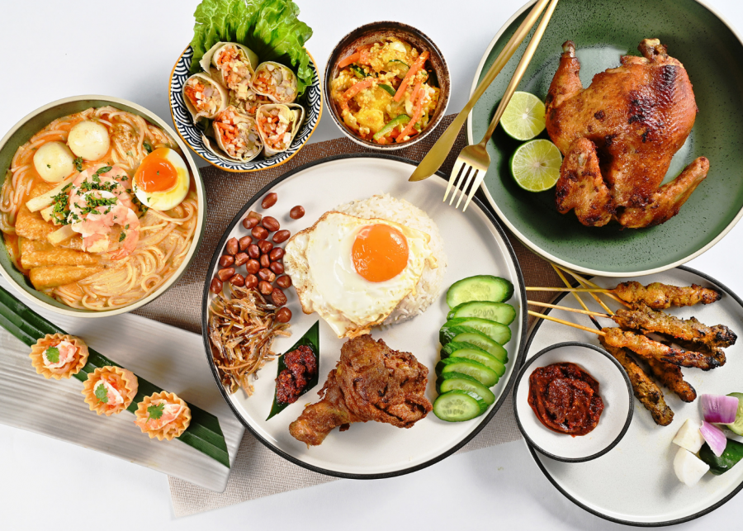
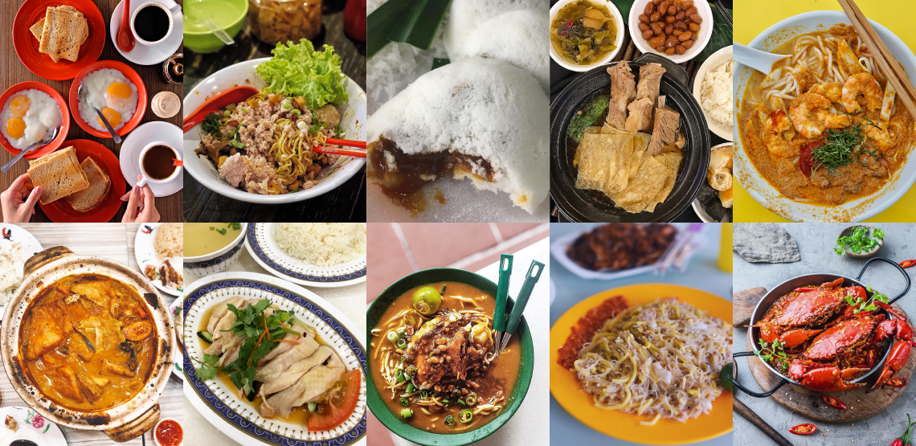
Singapore foods - aya toast, chilli crab, fish head curry, laksa, roti prata and Hainanese chicken rice

Slide 5
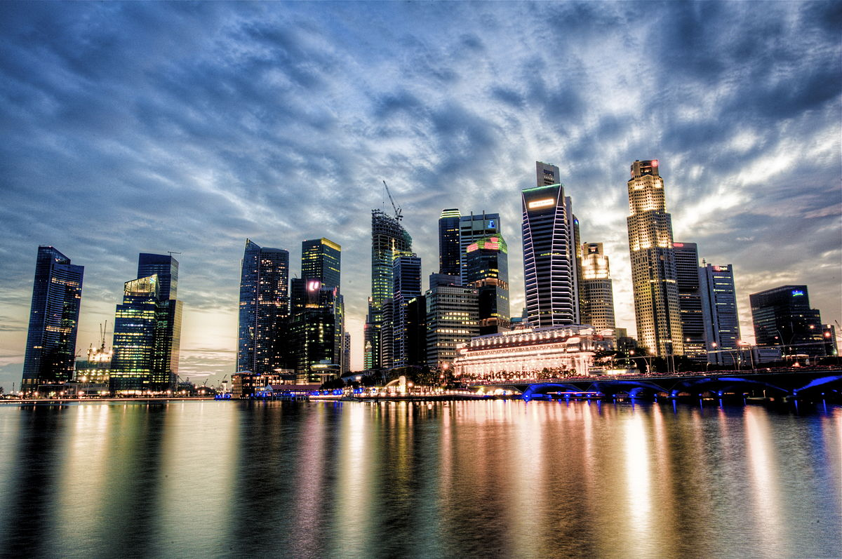
Best Places to visit in Singapore
Sentosa Marlion Tower
Universal Studios Singapore
Wings of Time
Singapore cable car
National Orchid Garden & Botanic Garden
Singapore Flyer

Slide 6
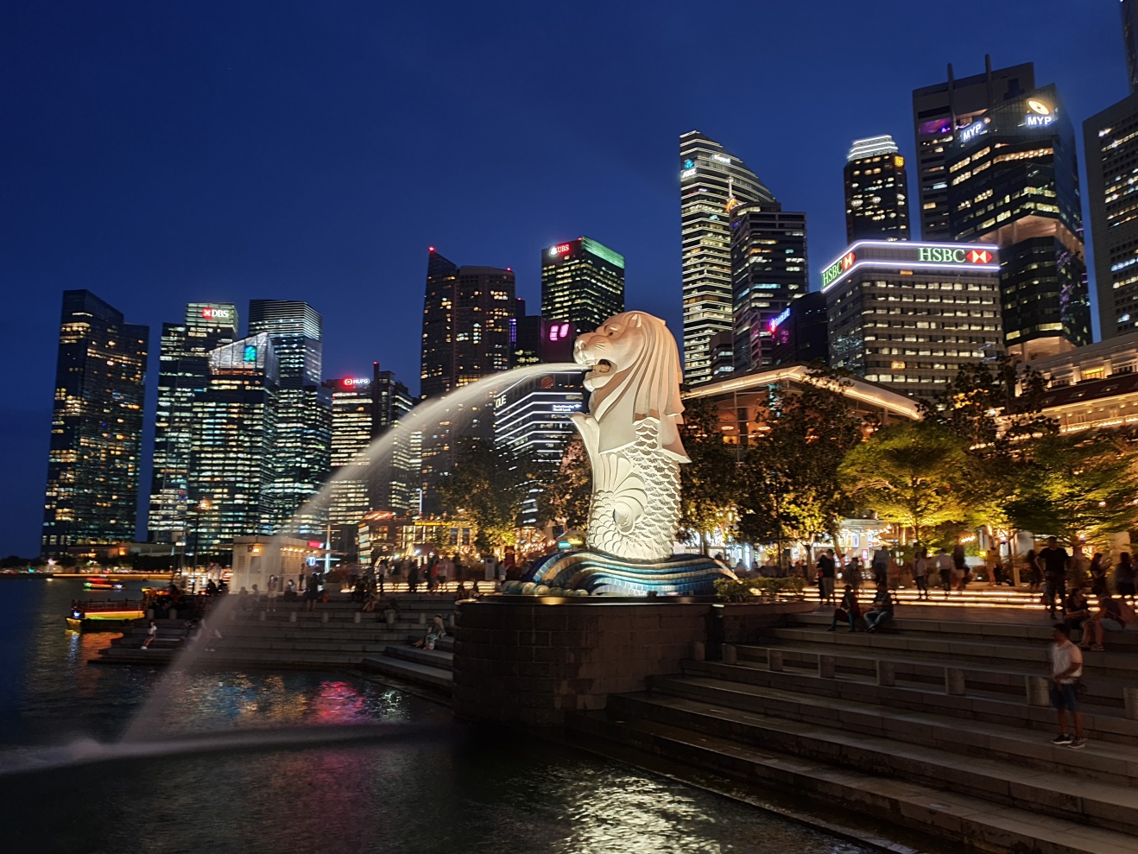
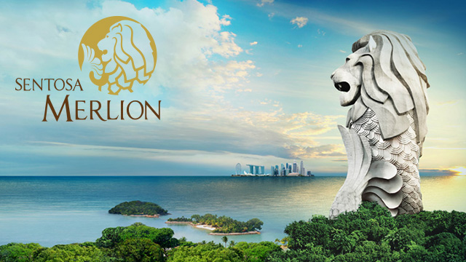
Sentosa Merlion Towers
Notes:
The Merlion is a mythical creature with a lion's head and the body of a fish that is widely used as a mascot and national personification of Singapore. Two Merlion statues are located at the park. The original Merlion structure measures 8.6 meters tall and spouts water from its mouth.

Slide 7
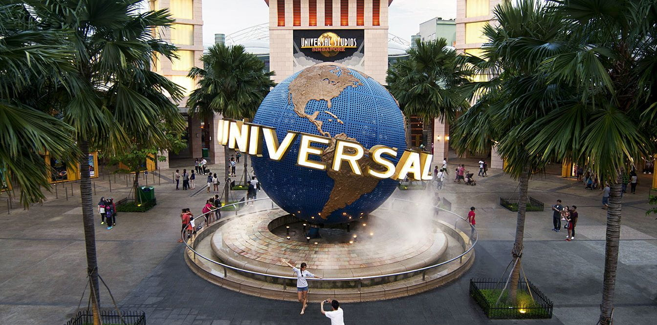
Universal Studios Singapore
Notes:
Universal Studios Singapore is a theme park located within the Resorts World Sentosa at Sentosa, Singapore. It features 28 rides, shows, and attractions in seven themed zones. It is one of the six Universal Studios theme parks around the world.

Slide 8
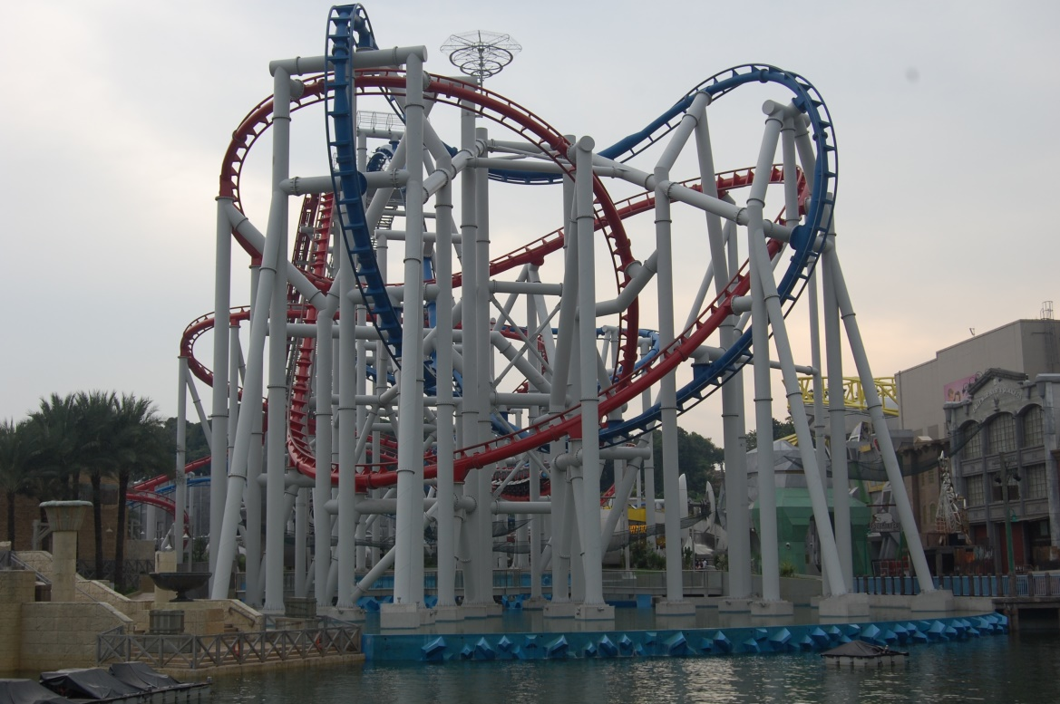

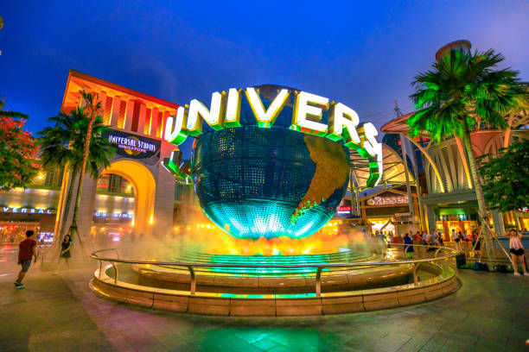

Slide 9
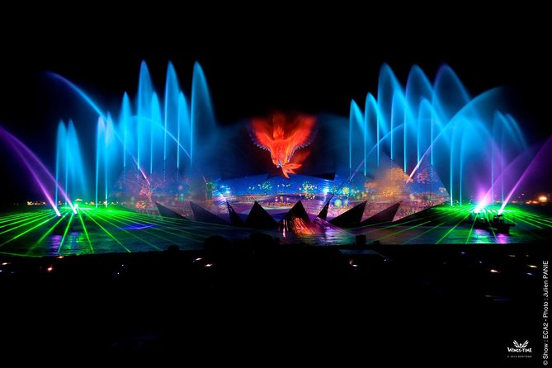
Wings of Time
Duration: 20 minutes per show.
Notes:
One of Sentosa's most popular multisensory experiences, Wings of Time is a fireworks show that won't disappoint. Best of all, it happens every night! Located beside Beach Station, Wings of Time commences at 7.40pm and 8.40pm nightly and lasts for 20 minutes.

Slide 10
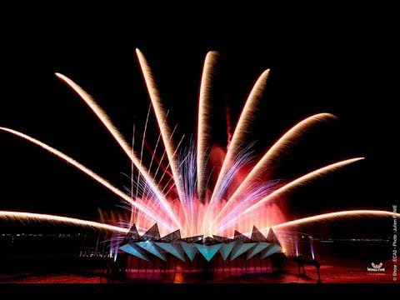
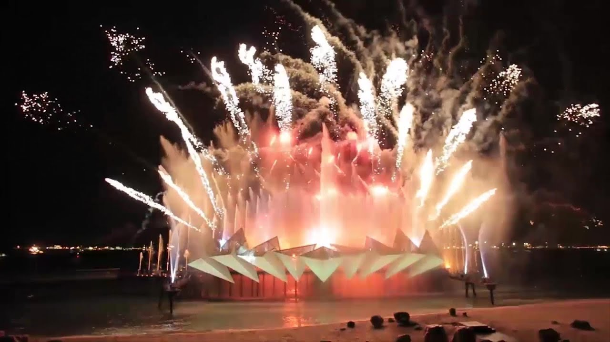
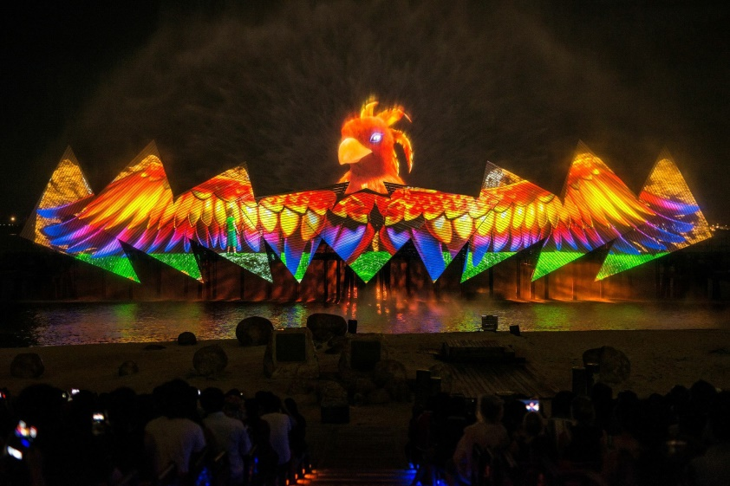

Slide 11
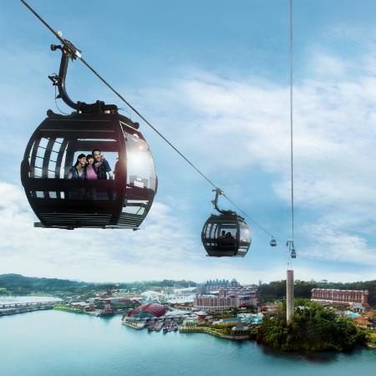
Singapore cable car
.
Carrier capacity - 67 cabins, maximum of 8 adult passengers per cabin, 2000 passengers per hour either way
Trip duration - 15 min
Line Length(Technologies Features) – 1,650 m (5,410 ft)
Notes:
The Singapore Cable Car is a gondola lift providing an aerial link from Mount Faber on the main island of Singapore to the resort island of Sentosa across the Keppel Harbour.

Slide 12
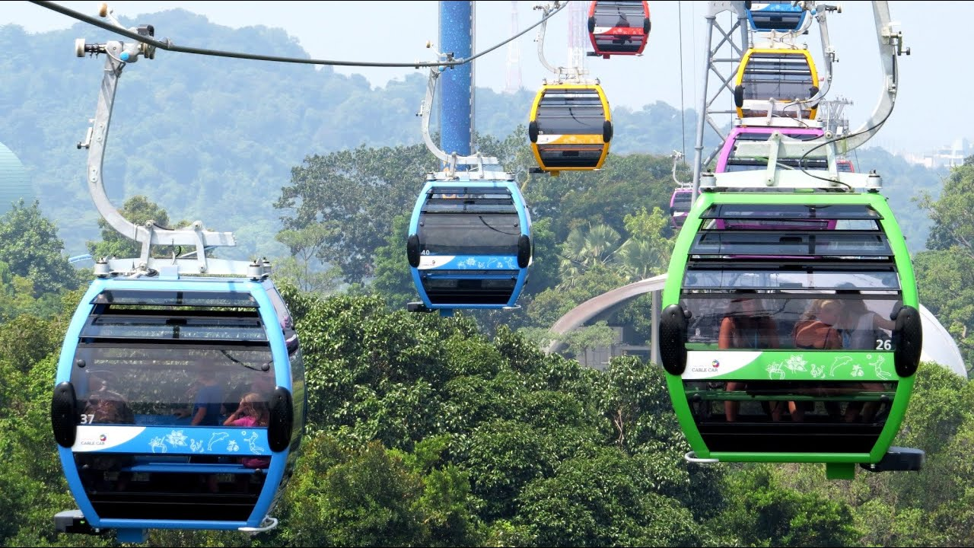
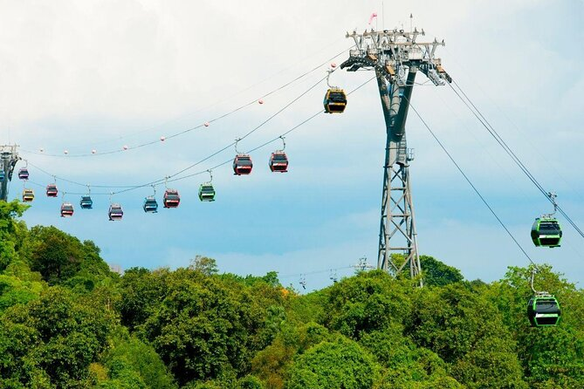
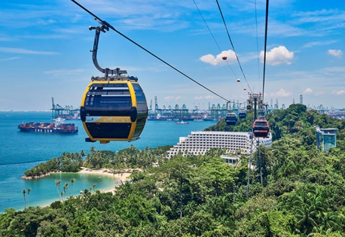
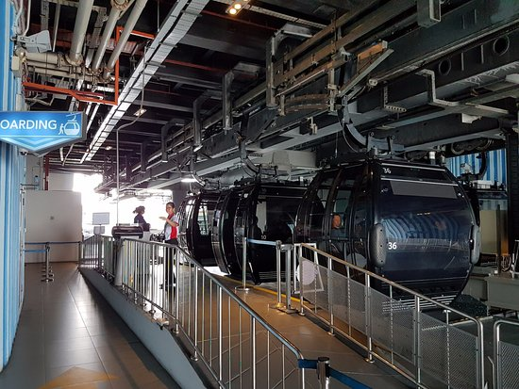

Slide 13
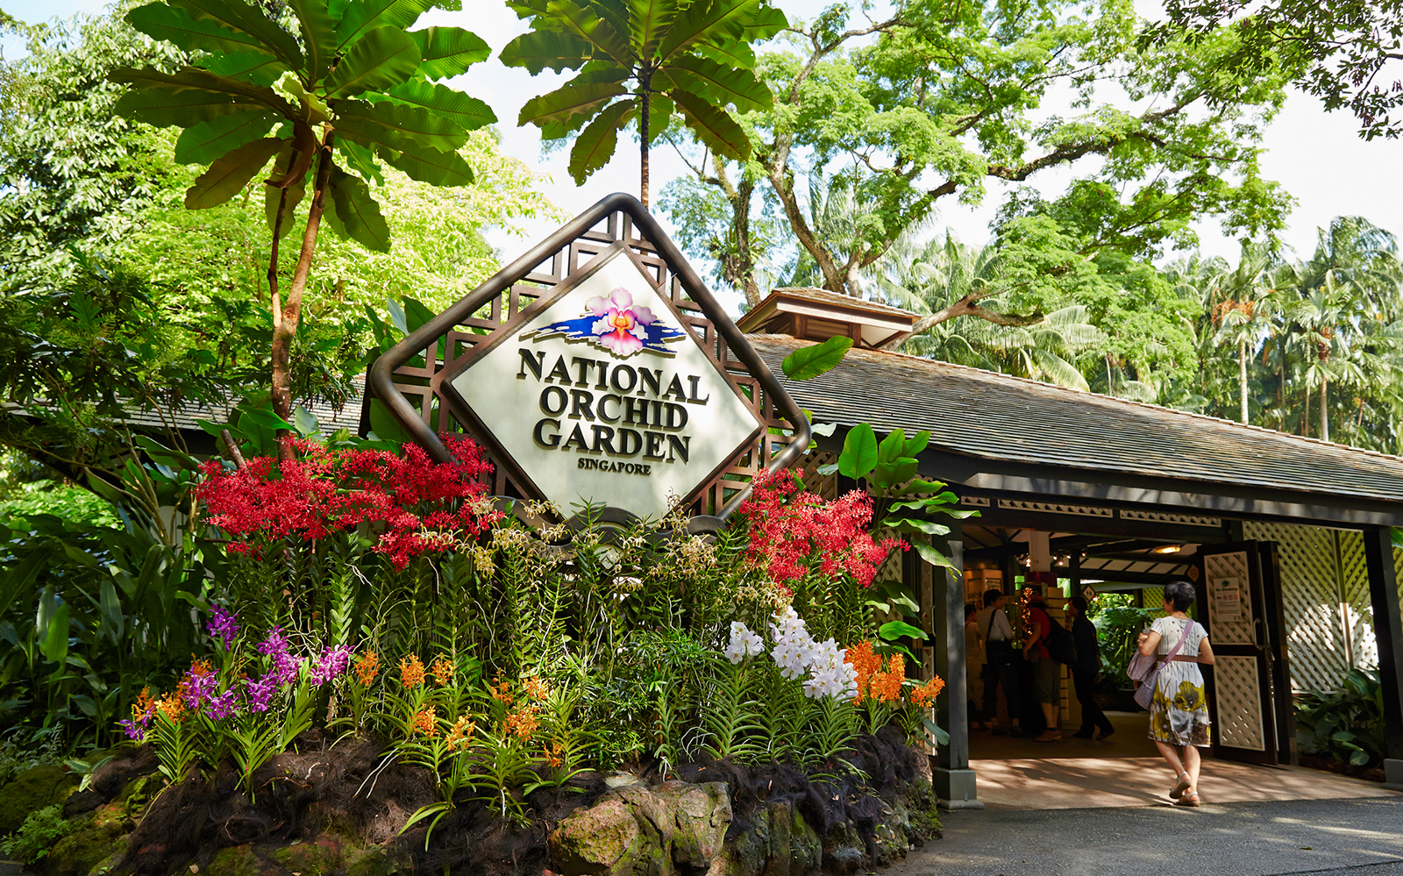
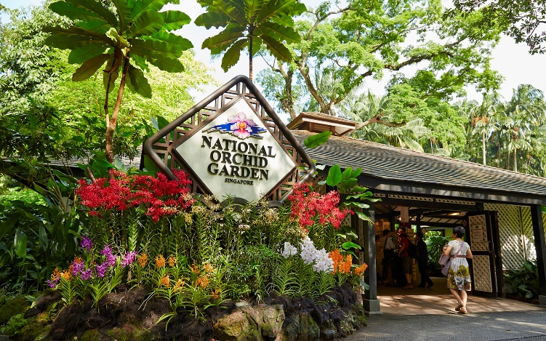

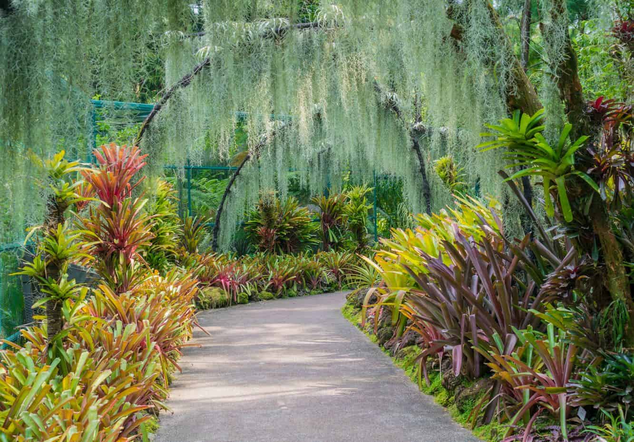
National Orchid Garden
Home to the world famous Orchid Garden of Singapore.
Opened on 20 October 1995 by Senior Minister Lee Kuan Yew.
Notes:
The National Orchid Garden, located within the Singapore Botanic Gardens, was opened on 20 October 1995 by Senior Minister Lee Kuan Yew. The Singapore Botanic Gardens has been developed along a 3-Core Concept.
The 158-year-old gardens are located on the edge of the Orchard Road Shopping District and are home to the world famous Orchid Garden of Singapore. Sprawled over 82 hectares, the gardens have over 10,000 different species of plants and flowers and receive millions of visitors who come to the island every year.

Slide 14
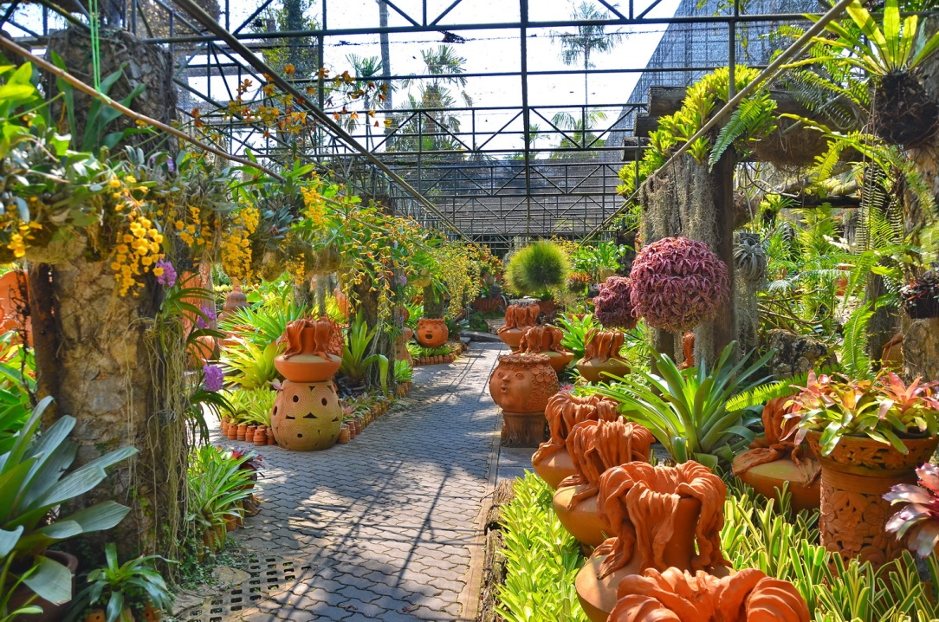
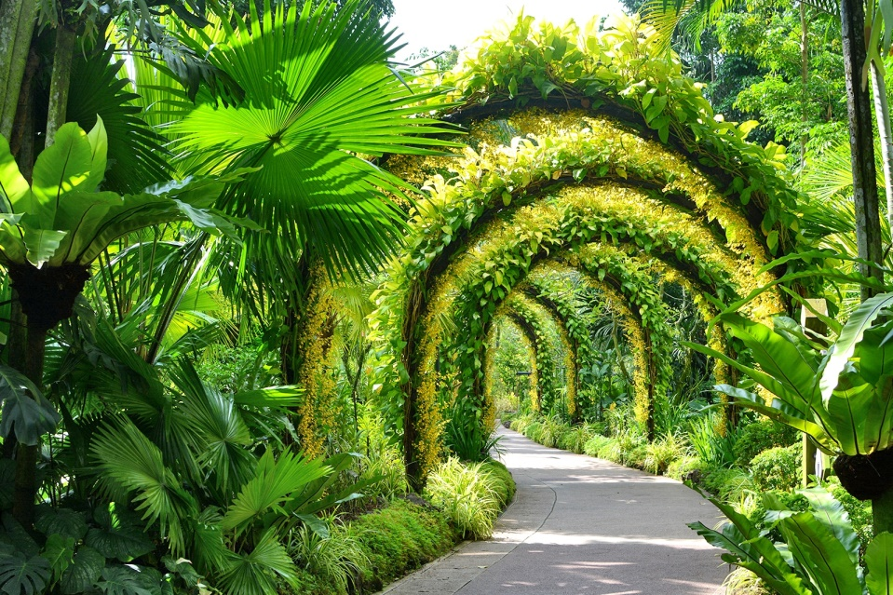
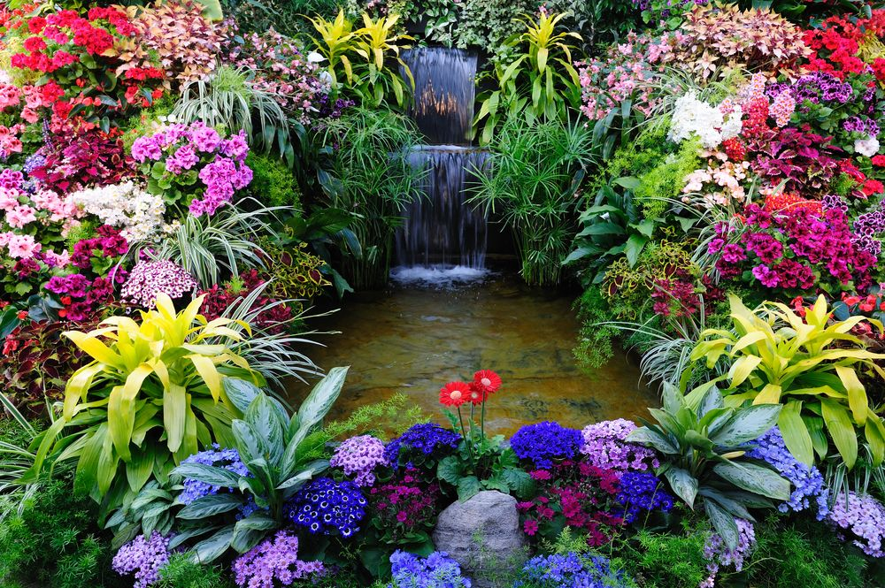
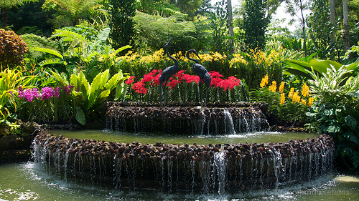

Slide 15
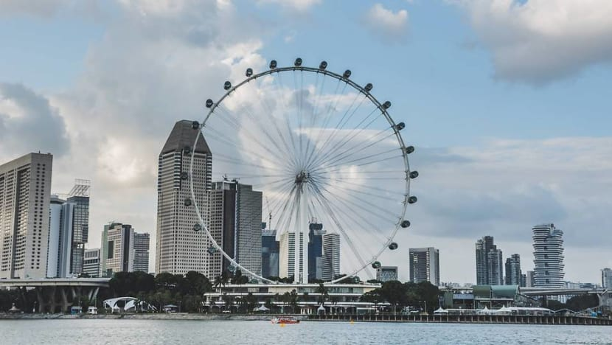
Singapore Flyer

Slide 16
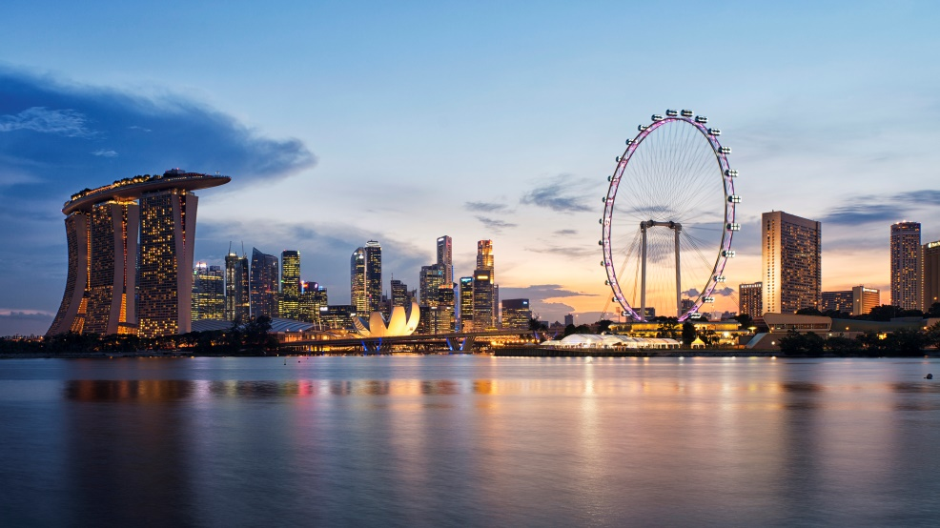
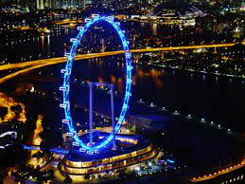
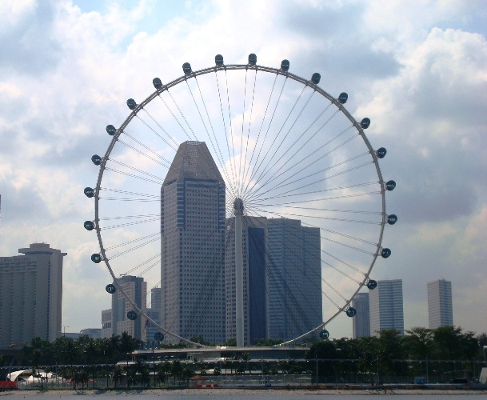
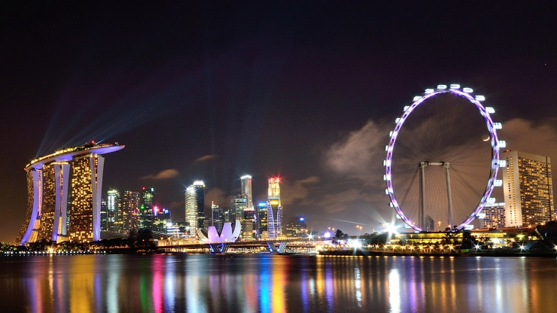

Slide 17
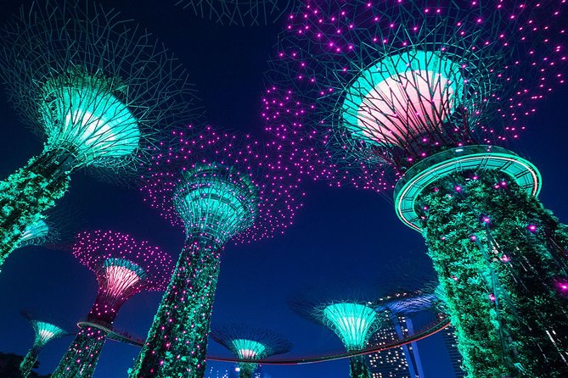
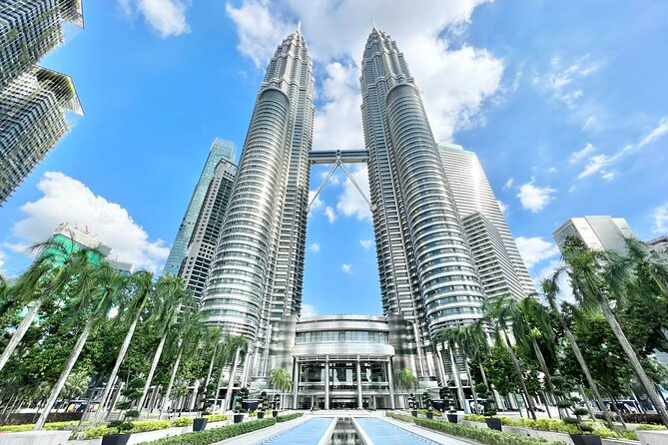
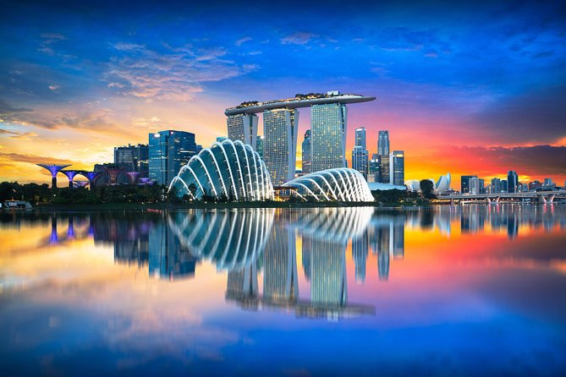
There are several other locations.
Nighttime Sightseeing with River Cruise
Kuala Lumpur & Malacca from Singapore by licensed guide
Singapore Car Tour

Slide 18
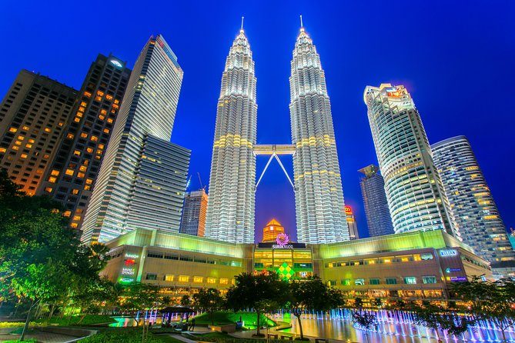
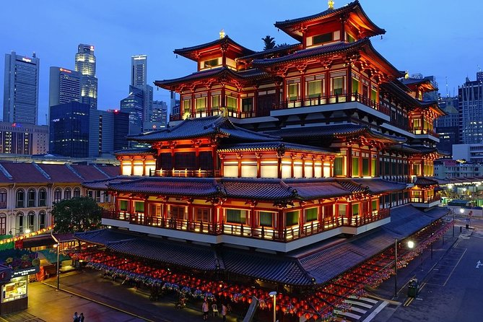
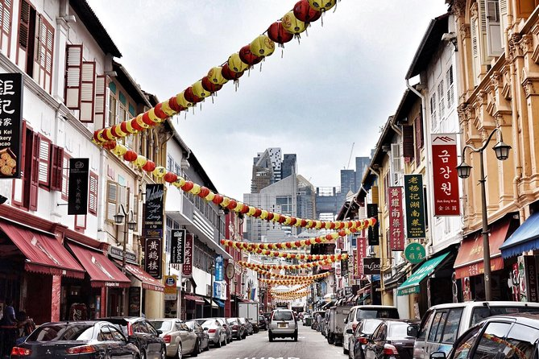
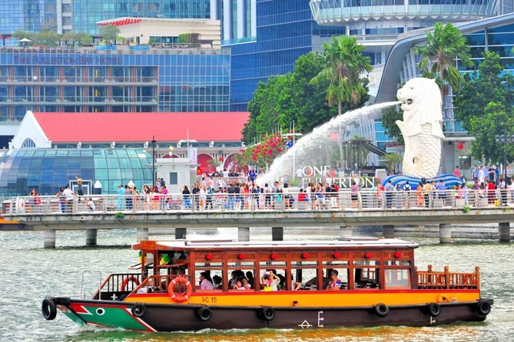
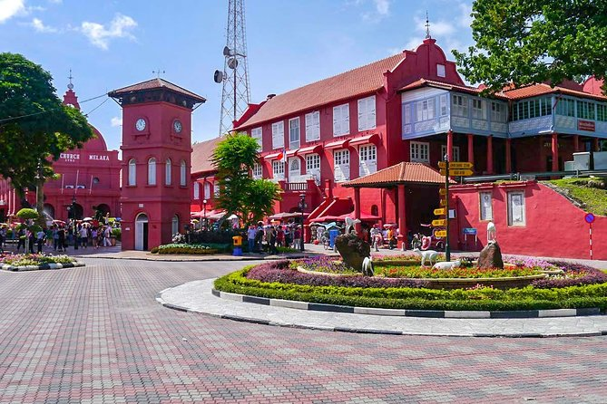
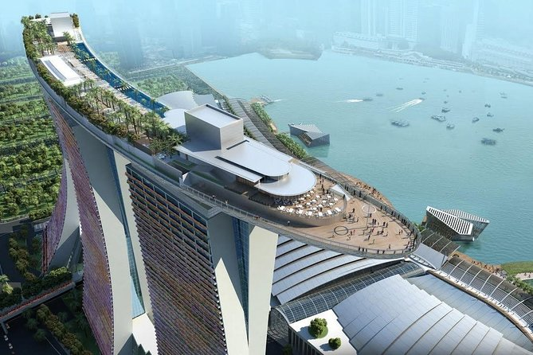
Go Car Fun Tour from Singapore
Singapore Tour in Private Car or Minibus with Driver
Private Shore Excursion of Singapore by walk
Singapore River Cruise
Malacca Tour from Singapore
Ocean Views with Marina Bay Sands Sky Park

Slide 19


Thank you!
Create By
A.Janani - E163886

